Slide 1
Statistics for Linguists
Adam J.R. Tallman
2021 06 15 / 2021 06 21 / 2021 06 29
Friedrich Schiller Universität Jena

Slide 2
From last lecture
Logistic regression
Multilevel models

Slide 3
This lecture
Multilevel models
Phoneme inventory vs. Population size
Exploratory vs. Confirmatory analysis
Clustering
Hierarchical clustering
K-mean clusters

Slide 4
Multilevel models

Slide 5
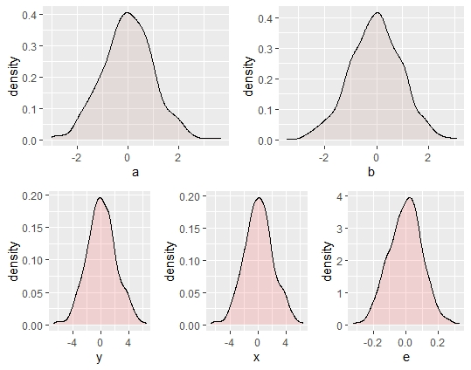
Multilevel regression and random variables
In such cases you have a random variable for the effects of your model.
That’s why multilevel models are sometimes called ‘random effects models’
…

Slide 6
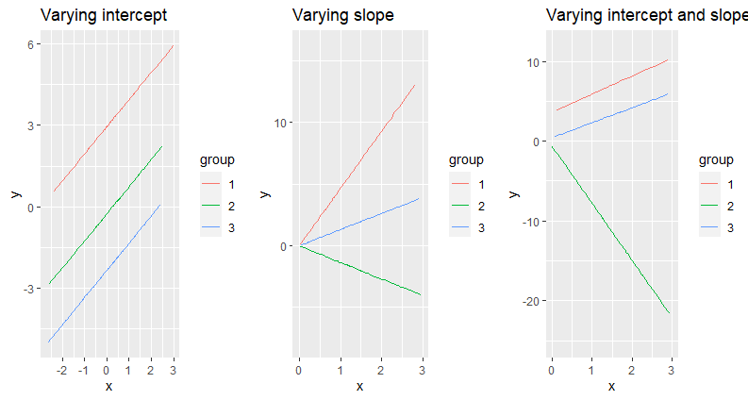
Multilevel regression and random variables

Slide 7
Why?
Why would we ever do this?
Why no just have lots of separate models for each group?

Slide 8
Schools
Imagine trying to assess the effectiveness of some new education curriculum of teaching style.
You have a treatment group and a control group and then you assess the students’ results.

Slide 9
Schools
But you know that there will be variation between schools.
Some schools won’t be able to effectively administer the training/treatment because they have less resources.
Furthermore, you have variation between schools with respect to how many students participated.
Schools vary in terms of their culture, socioeconomic conditions teachers, size, quality and style of education.
Yet, the students are all from the same population.

Slide 10
Schools
You have a measurement for aptitude y and you have a treatment variable (trained or not trained) x.
What do you do with the schools variable?
Complete pool
Run a regression ignoring the variation between schools
No pooling
Run a regression for each school
Run a regression with school as a factor

Slide 11
Complete pooling
Complete pooling has the obvious danger of ignoring the variation between schools.
If one school has more data points it could be an outlier with respect to the effects, but overwhelm the data across cases.
The results might be biased towards with more data points.

Slide 12
No pooling
No pooling could tend to exaggerate the variation between schools.
For schools that do not have very many data points, there is a higher likelihood of variation simply appearing by chance.
Think of the law of large numbers

Slide 13
Partial pooling
Multilevel modelling basically compromises between complete pooling and no pooling.
‘Multilevel modeling partially pools the group-level parameters α_{j} toward their mean μ_{α}. There is more pooling when the group-level standard deviation σ_{α} is small, and more smoothing for groups with fewer observations.’
Gelman & Hill (2009: 258)

Slide 14
Partial pooling
Partial pooling results in shrinkage of variance in the coefficients of each group towards the overall mean as a function of their in-group sample size (n_{j})
Shrinkage is less as your in-group sample size is larger.
Partial pooling towards the mean.

Slide 15
Multilevel models
Classical regression models can be viewed as a special case of multilevel models
As σ_{α}→ 0 the model is more like a complete pooling model.
As σ_{α}→ ∞ the model is more like a no-pooling model.

Slide 16
Fixed or random effects?
The literature on statistics makes a distinction between fixed and random effects.
In my statistics training I was taught two conflicting definitions.
Fixed -> the coefficient is a single constant; Random -> the coefficient comes from a random variable.
Fixed -> Sample exhausts the population of effects; Random -> any other type of group.

Slide 17
Fixed or random effects?
Gelman (2005) ‘Analysis of Variance – why it is more important than ever’ The Annals of Statistics summarizes a number of not necessarily consistent definitions.

Slide 18
Gelman (2005) definitions of fixed and random effects
1. Fixed effects are constant across individuals, and random effects vary . For example in a growth study a model with random intercepts α_{i} and fixed slope β corresponds to parallel lines for different individuals i, or the model y_{it} = α_{i} + βt.
2. Effects are fixed if they are interesting in themselves or random is there is interest in the underlying population.
3. “When a sample exhausts the population the corresponding variable is fixed; when the sample is a small (i.e. negligible) part of the population the corresponding variable is random” [Green and Tukey (1960) quoted in Gelman (2005: 20)]

Slide 19
Gelman (2005) definitions of fixed and random effects
4. “If an effect is assumed to be a realized value of a random variable, it is called a random effect [LaMotte (1983) cited in Gelman (2005)]
5. Fixed effects are estimated using least squares (or more generally maximum likelihood) and random effects are estimated with shrinkage [“linear unbiased prediction”…]

Slide 20
Constant vs. varying effects
Gelman (2005) suggests using the term constant if the effect is identical for al groups in the population and varying if they are allowed to differ from group to group.

Slide 21
Population size vs.phoneme inventory size

Slide 22
Population size vs.phoneme inventory size
A number of researchers had proposed a relationship between population size and phoneme inventory size.
Isolation+monolingualism -> small phoneme inventory
Haudricort
A few studies found a correlation between population size and small phoneme inventory size.
Assuming population is a proxy for isolation and monolingualism [!], perhaps Haudricort’s hypothesis has some validity.

Slide 23
Previous studies
Moran et al. 2012 mention three types of methodologies.
1. Case studies
2. Computer simulations
3. Statistical modelling

Slide 24
Previous studies
Moran et al. 2012 mention three types of methodologies.
1. Case studies -> Confirmation bias
2. Computer simulations -> Not realistic? No empirical support
3. Statistical modelling -> Different sampling or different measurement technique gets different results

Slide 25
Sampling problem
How do we choose languages so that the sampling is not biased towards particular families?
Bibliographic bias: Data tend to include families that are well documented.

Slide 26
Other problems
Spearman’s rho is overly permissive
(since its any monotonic relationship)
Statistical significance may not be informative with high sample sizes
We should be interested in effect size

Slide 27
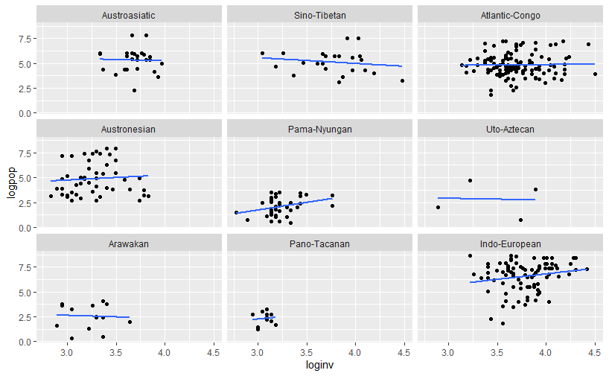

Slide 28
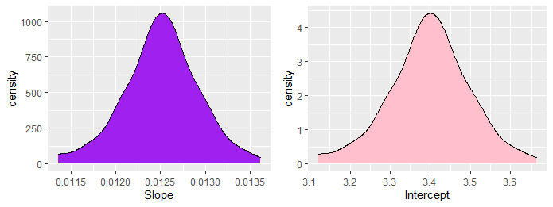
Practice
Let’s see if we can reproduce the results…

Slide 29
Exploratory data analysis

Slide 30
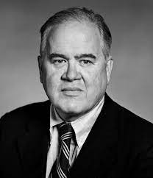
Exploratory data analysis
The basic ideas of exploratory data analysis were pioneered and articulated by John Tukey.
Developed Fast Fourier transforms, Tukey’s test, Tukey’s lemma etc.
Developed methods for visualizing data in order to probe assumptions of statistical models or to look for unexpected patterns.
Invented boxplots and a number of other visual techniques we now use today
Also invented the term ‘bit’
John Tukey 1915 - 2000

Slide 31
“The most important maxim for data analysts to heed, and one many statisticians seem to have shunned is this: “Far better an approximate answer to the right question, which is often vague, than an exact answer to the wrong question, which can always be made more precise.” Data analysts must progress by approximate answers at best, since its knowledge of what the problem really is will at best be approximate” Tukey (1962:62)
John Tukey 1915 - 2000

Slide 32
Exploratory data analysis
Some things that EDA is for ….
Guarding against erroneous conclusions from data
Looking for nonlinearity in the data (plotting techniques, should the data be logged, etc.?)
Advanced graphics (boxplots)
Model diagnostics (checking for heteroskedasticity, etc.)
Exploring the data to develop new hypotheses
EDA contrasts with CDA (confirmatory data analysis), or what I referred to as “Inferential statistics” earlier in the course.
EDA is about iterative hypothesis generation through interaction with the data.

Slide 33
Exploratory data analysis
Straight line paradigm vs. iterative approach to development of ideas.
Tukey (1980)
Exploratory data analysis is basically the detective work that goes on behind the scenes of confirmatory data analysis
Question Design Collection Analysis Answer
Question
Idea Collection Analysis Answer
Design

Slide 34
Algebra lies
Imagine a model as follows:
y = a + bx + e
Where a is 3 and b is 0.5.
There are a variety of patterns that this could correspond to – remember you are assuming that

Slide 35
Algebra lies, so you need graphs
Data analysis is about summation or aggregation over data, but different ways of aggregating the data can provide different results.
Imagine x has a standard deviation of 3.3 and a mean of 9
Imagine y has a standard deviation of 2 and a mean of 7.5.
For y = a + bx + e, a = 3 and b = 0.5
There are actually a lot of different patterns that can correspond to this statistical summation.

Slide 36
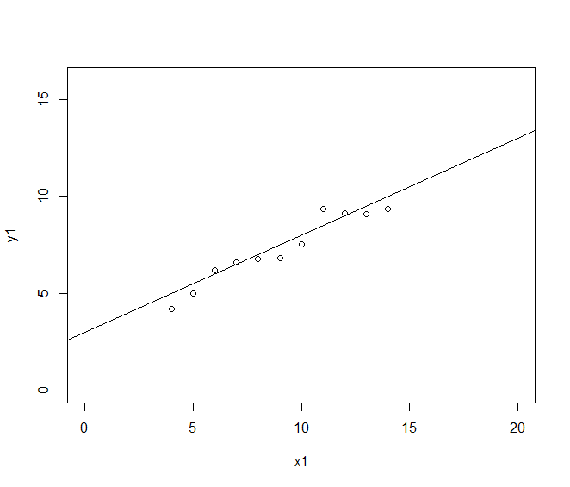
set.seed(3)
x1 <- seq(4,14,by=1)
y1 <- 3 + 0.5*x1+ rnorm(11,0,0.7)
plot(x1,y1, xlim=c(0,20), ylim=c(0,16))
abline(a=3, b = 0.5 )

Slide 37
Simulating very different data
x2 <- c(4, 5, 6, 7, 8, 9, 10, 11, 12 ,13 , 14)
y2 <- c(3, 4.5, 6, 7.25, 8, 8.5, 9, 9.25, 9 ,8.5, 8)
lm(y2~x2)
plot(x2,y2, xlim=c(0,20), ylim=c(0,16))
abline(a=3, b = 0.5 )
x3 <- seq(4,14)
y3 <- 4.75 + 0.25*x3
y3[10] = 15
lm(y3~x3)
plot(x3,y3, xlim=c(0,20), ylim=c(0,16))
abline(a=3, b = 0.5 )
x4 <- rep(8,10)
x4[11] <- 18
y4 <- seq(5,10, by =0.5)
y4[11] <- 12.25
lm(y4~x4)
plot(x4,y4, xlim=c(0,20), ylim=c(0,16))
abline(a=3.25, b = 0.5 )

Slide 38
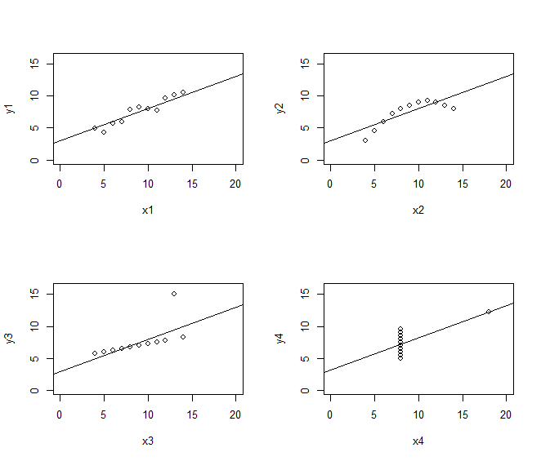
These will all give you roughly the same result for the slope and intercept.
But it is obvious that the model is only good for the first graph.
Slope = 0.5
Intercept = 3
The point is that without a visual exploration of the data and/or any attempt to test modelling assumptions, your model will make bad predictions.

Slide 39
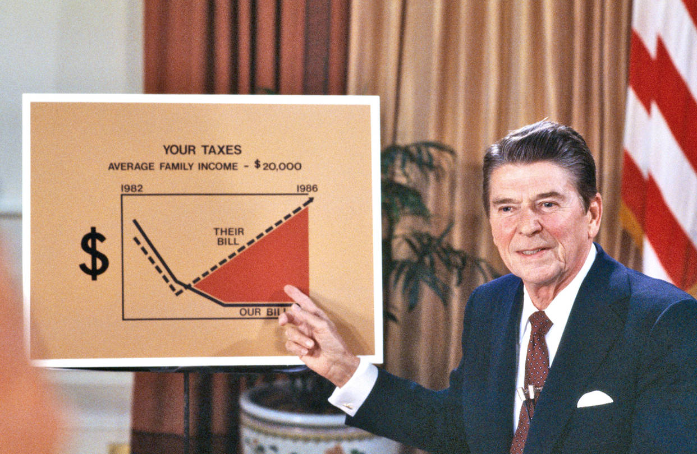
Graphs lie, so you need algebra
It’s easy to give misleading figures – or its easy to give figures that deceive.
Governments and other institutional bodies with a vested interest the public or stakeholders not knowing the truth of the situation are experts in this.
Great example: University administrators in the US!

Slide 40
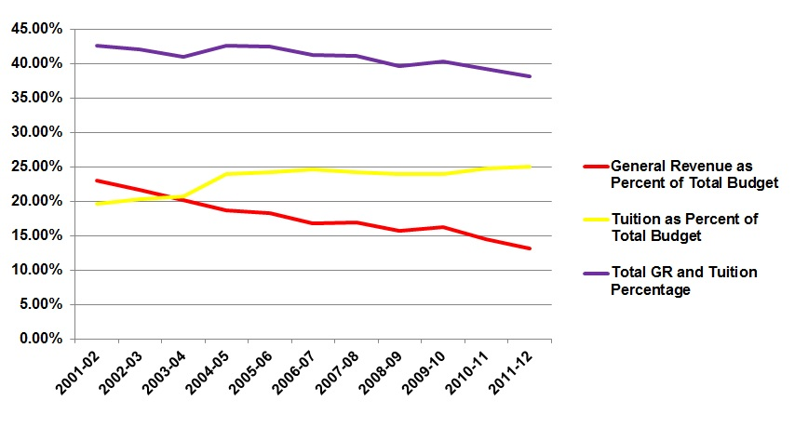
UT Austin, tuition increase arguments
UT Austin administration uses this graph to argue in favor of tuition increases to this day.

Slide 41
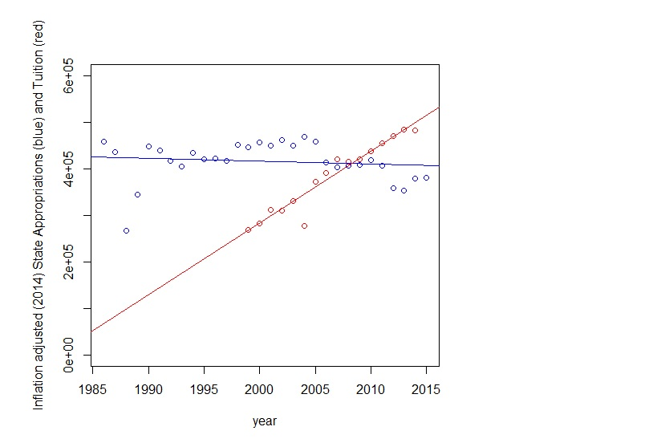
UT Austin, tuition increase arguments
Here’s another (more honest) graph that we produced looking at the relationship between tuition revenue and state appropriations over time.

Slide 42
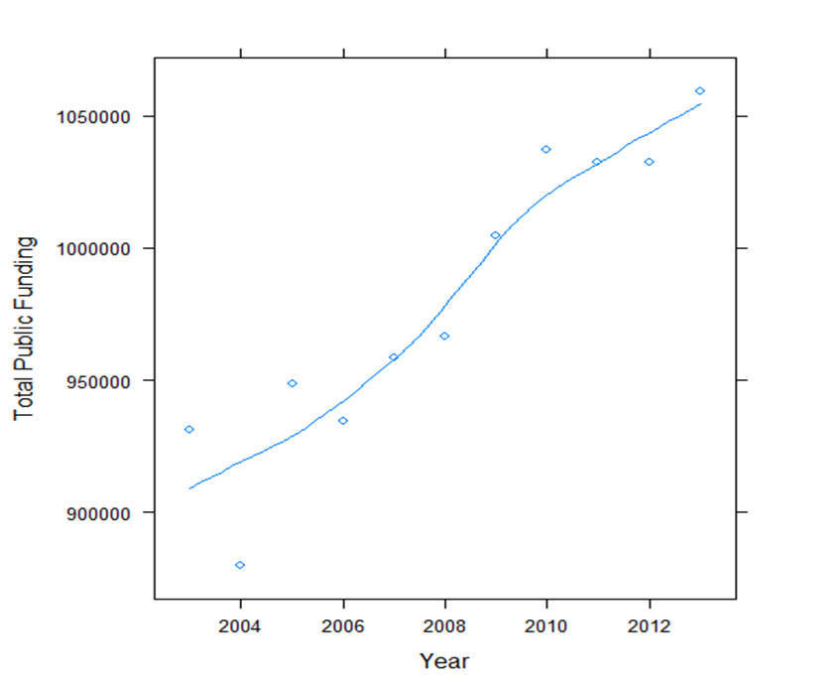
UT Austin, tuition increase arguments
Here’s how much actual public funding the university has from 2004-2013.

Slide 43
Graphs lie, so you need algebra
It is also very easy to deceive yourself with graphs, because the graphing algorithm can do something to the data that you don’t expect.
x5 <- c(1,1,2,2,3,3,4,4,5,5,5,5,6,6,6,6,6,6,7,7,7,7,8,8,9,9,10,10,11,11)
par(mfrow=c(2,2))
hist(x5, col="skyblue3")
hist(x5, col="skyblue3", breaks=10)
hist(x5, col="skyblue3", breaks=5)
hist(x5, col="skyblue3", breaks=c(0,1,2,3,4,5,6,7,8,9,10,11))

Slide 44
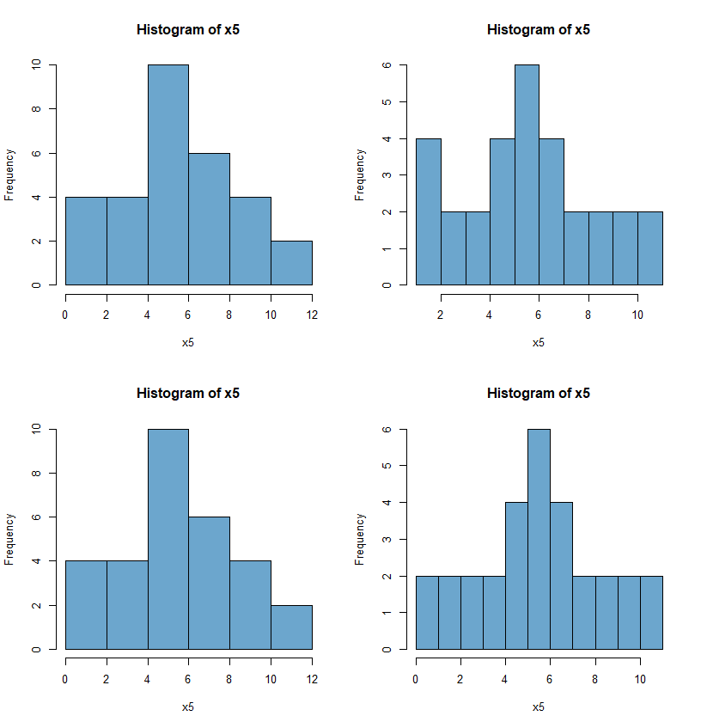
These are all from the same data, but setting the bins and bin spacing differently.
We know that only the last one is an accurate representation of the data.

Slide 45
Hiding structure
Certain types of graphs can also hide structure.
The boxplot is a graph based on a 5 number summary of the data.
The median, the first and second quartile and the lowest and highest numbers or something else separating extreme values (e.g. 5% / 95% confidence intervals).
All graphical techniques hide certain aspects of structure, even boxplots.

Slide 46
Hiding structure
group1 <- NULL
group1$y <- c(11,11,10,10,9,9,8,8,7,7,7,7,6,6,6,6,6,6,5,5,5,5,4,4,3,3,2,2,1,1)
group1 <- as.data.frame(group1)
group1$group <- 1
group2 <- NULL
group2$y <- c(11,11,11,11,11,11,11, 8,8,8,8,8,8,8,8,4,4,4,4,4,4,4,4,1,1,1,1,1,1,1)
group2 <- as.data.frame(group2)
group2$group <- 2
groups <- rbind(group1,group2)

Slide 47
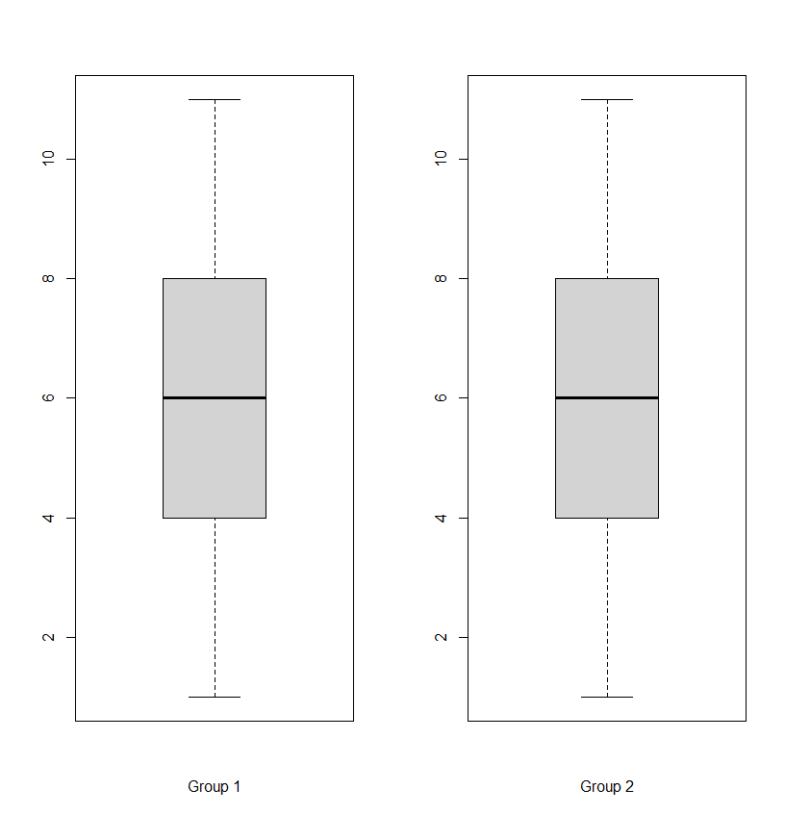
par(mfrow=c(1,2))
boxplot(group1$y, xlab="Group 1")
boxplot(group2$y, xlab= "Group 2")

Slide 48
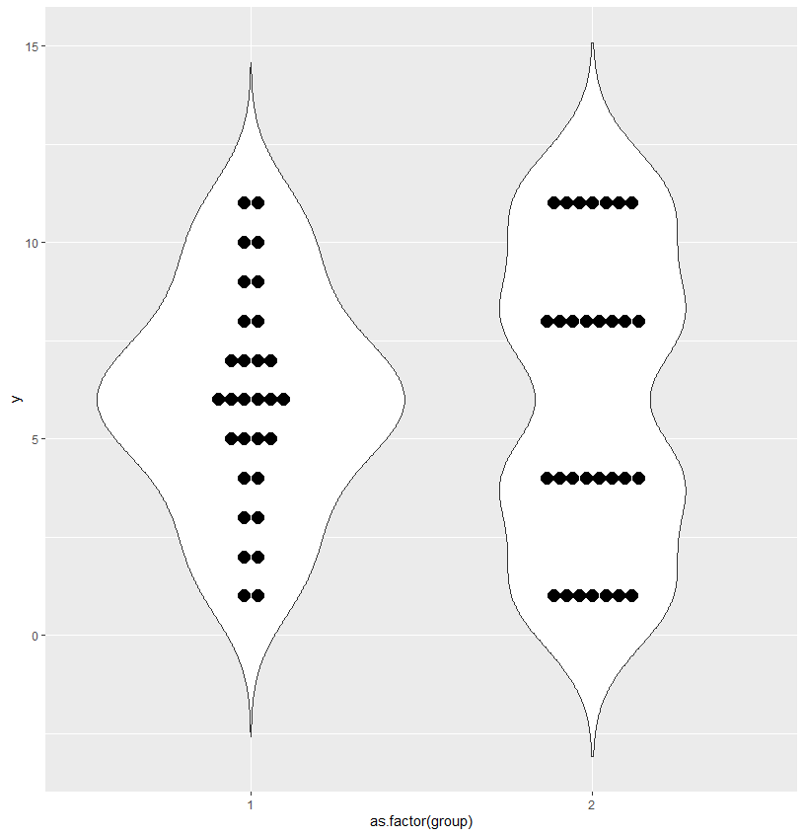
Dot plot
A dot plot in this case might be more revealing.
ggplot(groups, aes(x=as.factor(group), y=y))+
geom_violin(trim=FALSE)+
geom_dotplot(binaxis='y', stackdir='center')

Slide 49
Clustering

Slide 50
Classification vs. clustering
There are two powerful statistical tools for EDA, beyond graphing.
Supervised learning or classification is when the categories are labelled in your data.
E.g. random forests / decision trees
Unsupervised learning or clustering is when the categories are unlabeled.

Slide 51
Clustering analysis
Clustering analysis falls under the umbrella of exploratory data analysis.
Although there is quite a bit of literature on using validation techniques that have a confirmatory / inferential flavor – its sort of a madhouse though.

Slide 52
Clustering analysis
When are you going to use clustering…
You don’t have a distinction between dependent and independent variables in your data, just a hypothesis (or set of hypotheses) about the distribution of variables being related by being in groups.

Slide 53
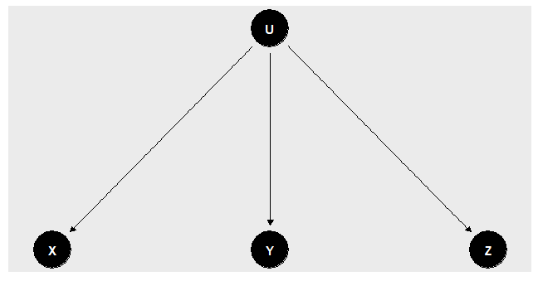
Clustering analysis
U is an an unmeasured variable (asume its a factor)
Let us say that U is responsable for the patterns we find in X, Y and Z.
Can we figure out the value of U for any given datapoint given X, Y and Z?

Slide 54
Clustering analysis
You can use various algorithms that group data points into groups according to overall closeness in a set of variables considered.
But there are a lot of different clustering algorithms.
Why?

Slide 55
Problems with clustering
Cluster has no meaning: There “is not standard or even useful definition of the term “cluster”, and many have argued that it is either too late or irrelevant to create one” (Aldenderfer & Blashfield 1984:33).
Clustering tendency problem: “the problem of deciding whether data exhibit a predisposition to cluster into natural groups without identifying the groups themselves. Clustering algorithms will create clusters whether the data are naturally clustered or purely random” (Jain & Dubes (1988: 201)

Slide 56
Cluster has no definition
Clusters are calculated based on some measurement of dissimilarity between datapoints.
Representation of some definition of intercluster dissimilarity; (a) Group average; (b) Nearest neighbor; (c) Furthest neighbour
(From Kauffman 1980: 47)

Slide 57
Cluster has no definition
Types of clusters
(a) Ball shapes
(b) elongated
(c) Compact but not well separated.

Slide 58
Domain dependence
“An ideal cluster can be defined as a set of points that is compact and isolated. In reality, a cluster is a subjective entity that is in the eye of the beholder and whose significance and interpretation requires domain knowledge. But, while humans are excellent cluster seekers in two and possibly three dimensions, we need automatic algorithms for high-dimensional data.”
(Jain 2010: 652)

Slide 59
Clustering algorithms
As EDA, clustering is well-known to be a useful tool, but as CDA …
The clustering tendency problem has not received a great deal of attention but is certainly an important problem. One want to believe that data are clustered and is naturally biased toward believing the results of a cluster analysis….
The validation of clustering structures is the most difficult and frustrating part of cluster analysis. Without a strong effort in this direction, cluster analysis will remain a black art accessible only to those true believers who have experience and great courage” (Jain & Dubes 1988)

Slide 60
Cluster analysis
Cluster analysis is used in …
Image segmentation
Document classification
Information retrieval
Marketing by classifying
Workforce management
Genome data

Slide 61
Clustering
Clustering methods can be divided into hierarchical and partitional
Hierarchical: Find nested hierarchically organized groups.
Partitional: No imposition of hierarchical structure.
In both cases, your data has to be organized into a (dis)similarity matrix (a matrix that tells you the distance of each data point vis-à-vis the variables in your dataframe).

Slide 62
Hierarchical clustering

Slide 63
Hierarchical clustering
There are two main approaches to hierarchical clustering
Agglomerative: bottom-up approach – and algorithm assumes that each data point is a group and groups those groups together one by one starting with the most similar ones, until all the data is one large cluster.
Divisive: top-down approach: Starts with everything in one large structure and breaks it down into smaller groups…
We are going to walk through the agglomerative approach because its more common.

Slide 64
Closeness
In order to start thinking about clustering we need some notion of “closeness” or “distance” between two data points.
Euclidean: The straight line distance between two points.
Manhattan: On a grid or lattice, how many units do you have to travel.

Slide 65
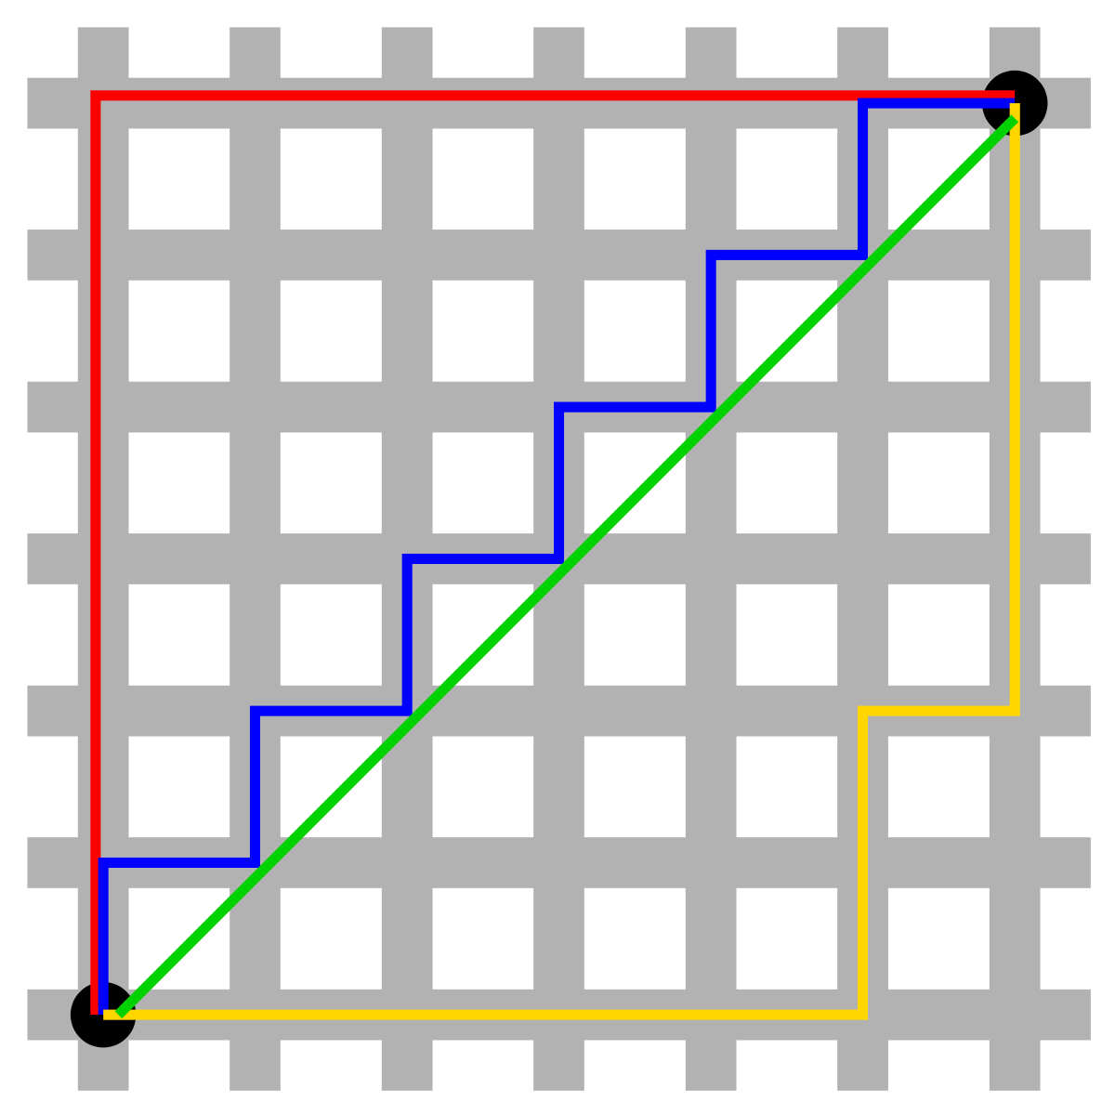
Euclidean vs. Manhattan
Euclidean is green.
Manhattan is all the other colors
https://commons.wikimedia.org/wiki/File:Manhattan_distance.svg

Slide 66
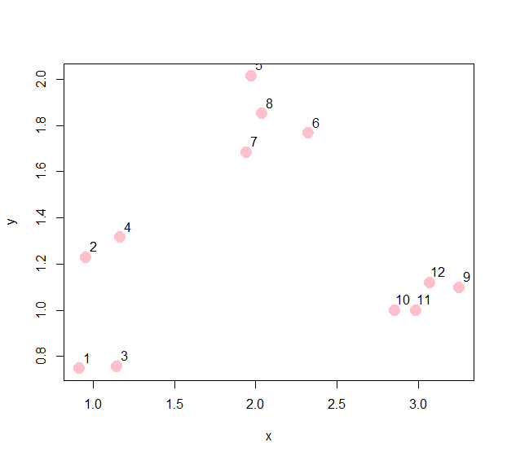
Agglomerative hierarchical cluster
Simulating data for clustering
set.seed(4321)
x <- rnorm(12, rep(1:3, each = 4), 0.2)
y <- rnorm(12, rep(c(1, 2, 1), each = 4), 0.2)
plot(x, y, col = "pink", pch = 19, cex = 2)
text(x + 0.05, y + 0.05, labels = as.character(1:12))

Slide 67
Calculating a distance matrix
You can calculate a distance matrix with the following code.
dataFrame <- data.frame(x=x, y=y)
dist(dataFrame)
1 2 3 4 5 6 7 8
2 0.4818060
3 0.2290071 0.5083847
4 0.6210186 0.2300065 0.5595680
5 1.6516473 1.2874484 1.5084603 1.0675884
6 1.7363507 1.4683435 1.5515341 1.2383578 0.4279533
7 1.3877613 1.0850453 1.2223180 0.8553386 0.3340584 0.3901532
8 1.5749957 1.2500236 1.4145687 1.0225625 0.1765242 0.2953299 0.1949666
9 2.3594401 2.2966216 2.1320837 2.0912494 1.5701360 1.1421832 1.4327423 1.4247104
10 1.9578445 1.9146662 1.7299970 1.7171607 1.3448566 0.9336432 1.1423308 1.1798333
11 2.0869817 2.0442189 1.8589258 1.8455955 1.4345148 1.0147559 1.2498504 1.2743264
12 2.1859159 2.1164159 1.9592779 1.9106631 1.4145273 0.9877883 1.2612721 1.2632629

Slide 68
Code for displaying the first merge
## Remove diagonal from consideration
diag(rdistxy)
diag(rdistxy) <- diag(rdistxy) + 100000
##Find the index of the points with minimum distance
ind <- which(rdistxy == min(rdistxy), arr.ind = TRUE)
ind
par(mfrow = c(1, 2))
plot(x, y, col = "pink", pch = 19, cex = 2)
text(x + 0.05, y + 0.05, labels = as.character(1:12))
points(x[ind[1, ]], y[ind[1, ]], col = "purple", pch = 19, cex = 2)
hcluster <- dist(dataFrame)
dendro <- as.dendrogram(hclust(hcluster))
plot(cut(dendro, h = 0.5)$lower[[3]])

Slide 69
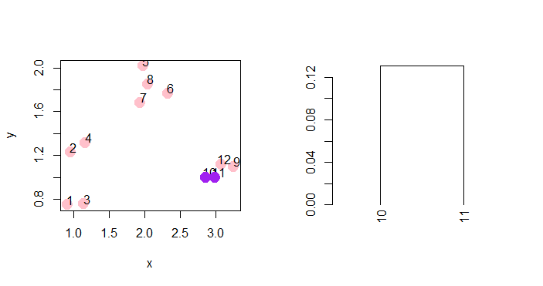
Agglomeration
Agglomerative method starts with the closest point and turns it into a group.

Slide 70
Code for second merge
nextmin <- rdistxy[order(rdistxy)][7]
ind2 <- which(rdistxy == nextmin,arr.ind=TRUE)
ind2
##Showing agglomeration
par(mfrow = c(1, 2))
plot(x, y, col = "pink", pch = 19, cex = 2)
text(x + 0.05, y + 0.05, labels = as.character(1:12))
points(x[ind[1, ]], y[ind[1, ]], col = "purple", pch = 19, cex = 2)
plot(x, y, col = "pink", pch = 19, cex = 2)
text(x + 0.05, y + 0.05, labels = as.character(1:12))
points(x[ind[1, ]], y[ind[1, ]], col = "purple", pch = 19, cex = 2)
symbols(x=c(2.93), y=c(1), circles=0.12, add=T, inches=F, pch=20, bg="pink")

Slide 71
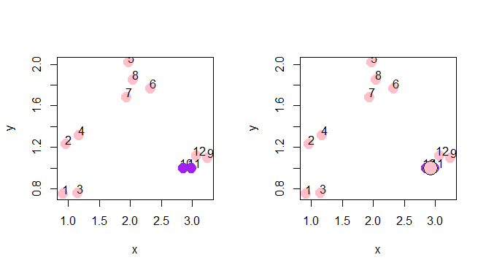
Agglomeration
After a group is formed it is treated as a single point in the next iteration of the algorithm

Slide 72
Code for cut dendrogram
par(mfrow = c(1, 3))
plot(x, y, col = "pink", pch = 19, cex = 2)
text(x + 0.05, y + 0.05, labels = as.character(1:12))
symbols(x=c(2.93), y=c(1), circles=0.12, add=T, inches=F, pch=20, bg="purple")
symbols(x=c(3.15), y=c(1.1), circles=0.15, add=T, inches=F, pch=20, bg="purple", cex=2)
plot(x, y, col = "pink", pch = 19, cex = 2)
text(x + 0.05, y + 0.05, labels = as.character(1:12))
points(x[ind[1, ]], y[ind[1, ]], col = "purple", pch = 19, cex = 2)
symbols(x=c(2.93), y=c(1), circles=0.12, add=T, inches=F, pch=20, bg="pink")
points(x[ind2[1, ]], y[ind2[1, ]], col = "purple", pch = 19, bg = "purple", cex=2)
symbols(x=c(3.15), y=c(1.1), circles=0.15, add=T, inches=F, pch=20, bg="pink", cex=2)
hcluster <- dist(dataFrame)
dendro <- as.dendrogram(hclust(hcluster))
plot(cut(dendro, h = 0.5)$lower[[3]])

Slide 73
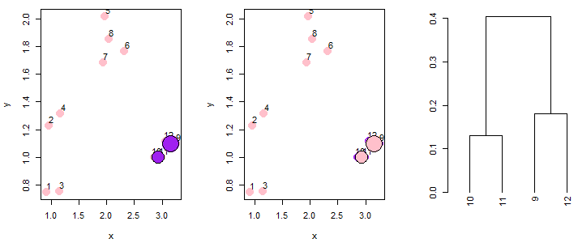
Agglomeration
After a group is formed it is treated as a single point in the next iteration of the algorithm

Slide 74
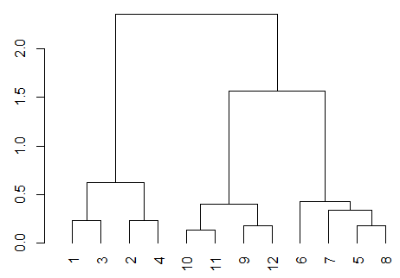
Dendrogram
The algorithm continues until it builds a tree.
This is called a dendrogram
plot(dendro)

Slide 75
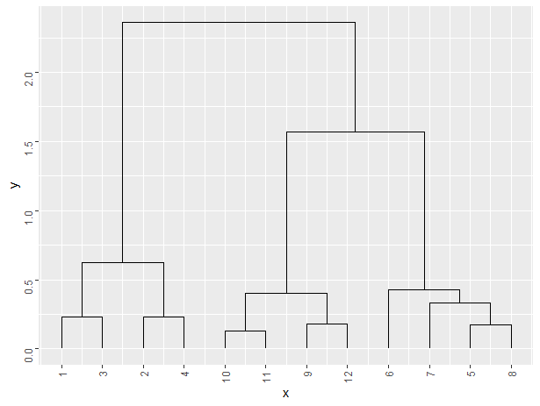
ggdendro
You can get nicer dendrograms with ggdendro()
library(ggplot2)
library(ggdendro)
ggdendrogram(dendro, theme_dendro = FALSE)

Slide 76
Assign clusters to vectors
You can assign the cluster labels back to the data.
groups <- cutree(clusters, k=2)
dataFrame$groups3 <- groups
dataFrame
x y groups3
1 0.9146485 0.7478030 1
2 0.9552776 1.2278928 1
3 1.1435214 0.7556436 1
4 1.1682891 1.3146632 1
5 1.9743285 2.0146956 2
6 2.3218694 1.7649770 2
7 1.9405665 1.6823476 2
8 2.0392009 1.8505239 2
9 3.2481492 1.0967044 2
10 2.8562604 0.9993949 2
11 2.9865527 0.9982139 2
12 3.0688734 1.1186715 2

Slide 77
Cluster validation
There are actually lots of R packages now that do types of cluster validation – providing p-values for cluster labels etc.
It is important to recognize that cluster validation (along with clustering itself) is very problem specific.
One common way of validating clusters is to compare the results to some null distribution.

Slide 78
Cluster validation
Let’s imagine that there are two values for U and they produce differential effects for x, y and z.
But we do not actually know what U is.

Slide 79
Cluster validation
Simulate data based on the causal graph.
u <- rbinom(50,1,.4)
bx <- 0.5
x <- bx*u + rnorm(50, 0, 1)
by <- -3
y <- by*u + rnorm(50, 0, 2)
bz <- 4
z <- bz*u + rnorm(50, 0, 2.5)
d <- data.frame(x,y,z)
glimpse(d)

Slide 80
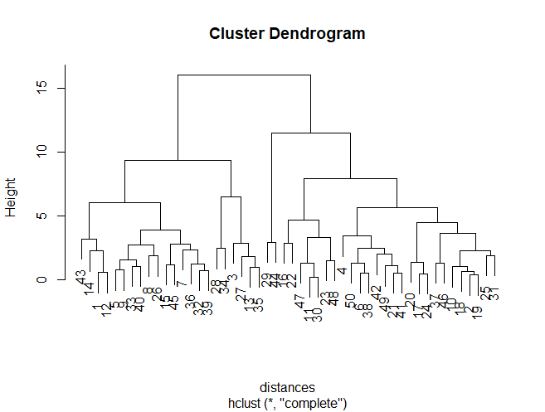
Cluster validation
Draw a dendrogram
distances <- dist(d) #Make a distance matrix
hc <- hclust(distances) #Make a hierarchical cluster
plot(hc) #plot the hierarchical cluster

Slide 81
Cluster validation
An external criterion would involve just assessing the degree to which the cluster model correctly got U
g <- cutree(hc, k=2)
d$g <- g -1
glimpse(d)
d$u <- u
table(d$u, d$g)
chisq.test(d$u, d$g)
0 1
0 22 9
1 0 19
Pearson's Chi-squared test with Yates' continuity correction
data: d$u and d$g
X-squared = 21.284, df = 1, p-value = 3.96e-06

Slide 82
Cluster validation
But the real world isn’t like this, otherwise we would just do a regression.
An internal criteria often (but not always) involves seeing if the groups are clustered into their respective groups better than chance.
So we simulate a null distribution and compare the results

Slide 83
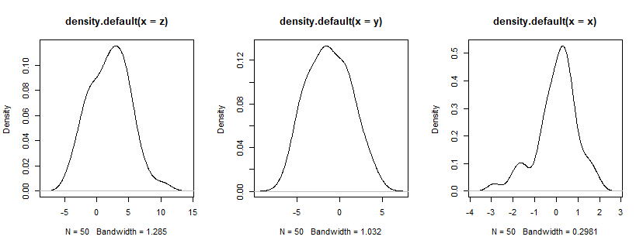
Cluster validation
We simulate null distributions as if U wasn’t a factor.

Slide 84
Cluster validation
Based on what we just saw, we can posit that the null distribution would be all of normally distributed.
We just construct a situation where they are unrelated to one another.
z.null <- rnorm(50, mean(z), sd(z))
y.null <- rnorm(50, mean(y), sd(y))
x.null <- rnorm(50, mean(x), sd(x))
d.null <- data.frame(x.null,y.null,z.null)
d.obs <- data.frame(x,y,z)
distances.null <- dist(d.null) #Make a distance matrix
hc.null <- hclust(distances.null) #Make a hierarchical cluster
distances.obs <- dist(d.obs) #Make a distance matrix
hc.obs <- hclust(distances.obs) #Make a hierarchical cluster

Slide 85
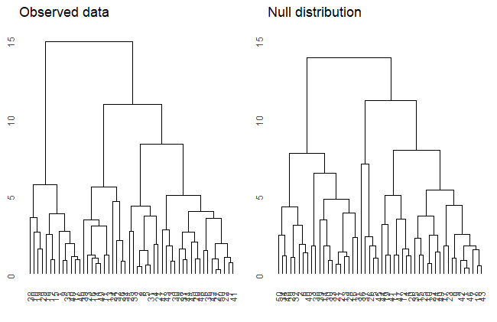
Cluster validation
p1 <- ggdendrogram(
as.dendrogram(hc.obs))+
ylim(0,15)+
ggtitle("Observed data")
p2 <- ggdendrogram(
as.dendrogram(hc.null))+
ylim(0,15)+
ggtitle("Null distribution")
grid.arrange(p1,p2, ncol=2)

Slide 86
Cluster validation
The height of the first partition is 3.9 for the observed data.
The height of the first partition for the simulated data is 2.7
length(hc.obs$height)
length(hc.null$height)
hc.obs$height[49] - hc.obs$height[48]
hc.null$height[49] - hc.null$height[48]

Slide 87
Cluster validation
In such cases, you’ll also want to calculate the cophenetic correlation.
This is the correlation between the distances based on clusters and the distances based on euclidean distance.
coph <- cophenetic(hc.obs)
cor.test(distances.obs, coph)
coph <- cophenetic(hc.null)
cor.test(distances.null, coph)
Pearson's product-moment correlation
data: distances.obs and coph
t = 26.913, df = 1223, p-value < 2.2e-16
alternative hypothesis: true correlation is not equal to 0
95 percent confidence interval:
0.5734549 0.6438902
sample estimates:
cor
0.6098755
Pearson's product-moment correlation
data: distances.null and coph
t = 24.293, df = 1223, p-value < 2.2e-16
alternative hypothesis: true correlation is not equal to 0
95 percent confidence interval:
0.5314773 0.6071135
sample estimates:
cor
0.5705038

Slide 88
Warning
There are lots of other validation techniques – and you can find many proposals implemented in R online.
Using clustering models requires a lot of thinking about the details of your specific problem – beware of the clustering tendency problem!

Slide 89
K-means clustering

Slide 90
K-means
K-means is the most used partitional clustering method.
You are trying to find center points over a fixed number of cloud like clusters in a hyper-dimensional space.
You probably don’t need K-means when you just have 2-dimensions…, but for more it becomes a useful tool.

Slide 91
K-means
Unlike hierarchical clustering you have to prespecify the number of clusters.
There’s no straightforward formula for getting the results of K-means clustering.
We use algorithms instead….

Slide 92
K-means
Rough summary of the algorithm
Fix the number of clusters at 2 or more
Centroids are placed randomly.
Points closest to each centroid are placed within its cluster
Reposition centroids and calculate again until distances are minimized.

Slide 93
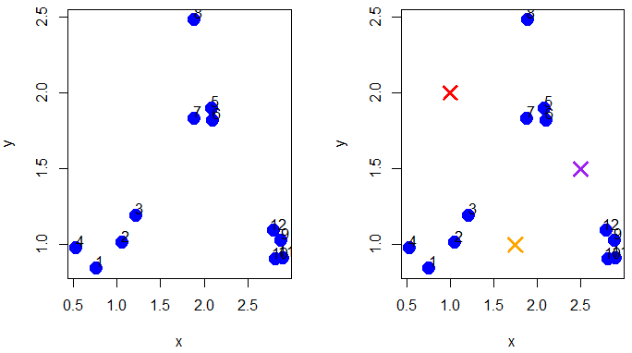
3 clusters
set.seed(1234)
x <- rnorm(12, mean = rep(1:3, each=4), sd=0.2)
y <- rnorm(12, mean = rep(c(1,2,1), each=4), sd=0.2)
plot(x,y, col="blue", pch=19, cex=2)
text(x+0.05, y +0.05, labels= as.character(1:12))
points(c(1,1.75,2.5), c(2,1,1.5), col = c("red","orange","purple"), pch = 4, cex=2, lwd=3)
points(c(x[4],x[8]), c(y[4],y[8]), col="red", pch=19, cex=2)
points(c(x[1],x[2],x[3]), c(y[1],y[2],y[3]), col="orange", pch=19, cex=2)
points(c(x[5], x[6], x[7], x[9], x[10], x[11], x[12]), c(y[5], y[6], y[7], y[9], y[10], y[11], y[12]), col="purple", pch=19, cex=2)

Slide 94
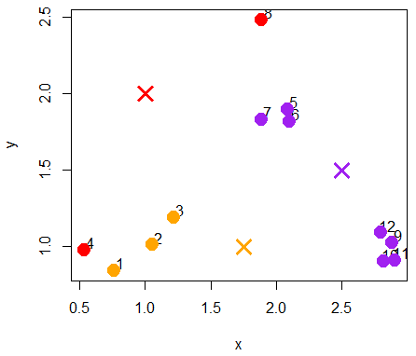
Assign data points to clusters
Assign data points to clusters based on minimal distances

Slide 95
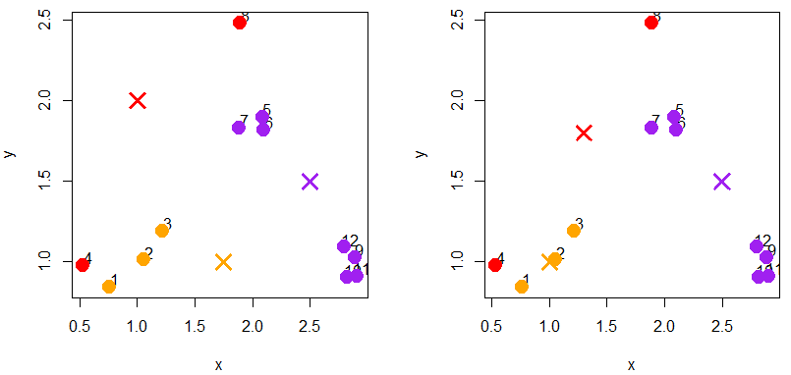
Move centroids closer to data points
Move the centroids closer to data

Slide 96
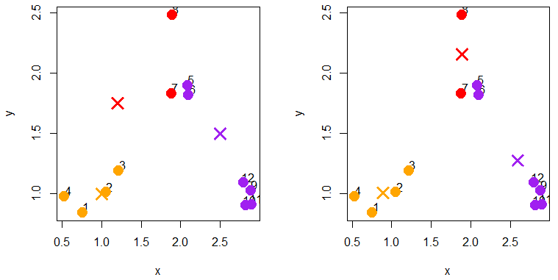
Reassign data points to centroids
Reassign data points after centroids are reassigned, then move centroids again …

Slide 97
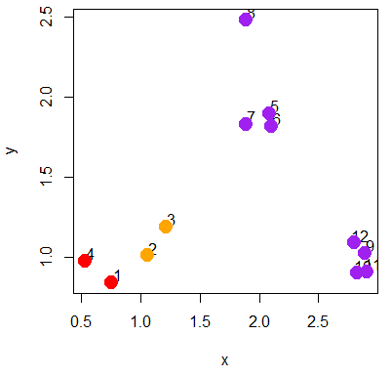
K-means in R
Running k-means is pretty simple.
x y groups
1 0.7585869 0.8447492 3
2 1.0554858 1.0128918 1
3 1.2168882 1.1918988 1
4 0.5308605 0.9779429 3
5 2.0858249 1.8977981 2
6 2.1012112 1.8177609 2
7 1.8850520 1.8325657 2
8 1.8906736 2.4831670 2
9 2.8871096 1.0268176 2
10 2.8219924 0.9018628 2
11 2.9045615 0.9118904 2
12 2.8003227 1.0919179 2
df <- data.frame(x,y)
kmeansobj <- kmeans(df, centers=3)
names(kmeansobj)
kmeansobj$cluster
df$groups <- kmeansobj$cluster

Slide 98
Hierarchical clustering

Slide 99
Affixes, clitics and words
Affixes – pieces of words
Words – parts of phrases
Clitics – something in between
There are no sufficient and necessary criteria for distinguishing these.

Slide 100
Grammaticalization
Affix > clitic > word
Is a global distinction between morphology and syntax supported?

Slide 101
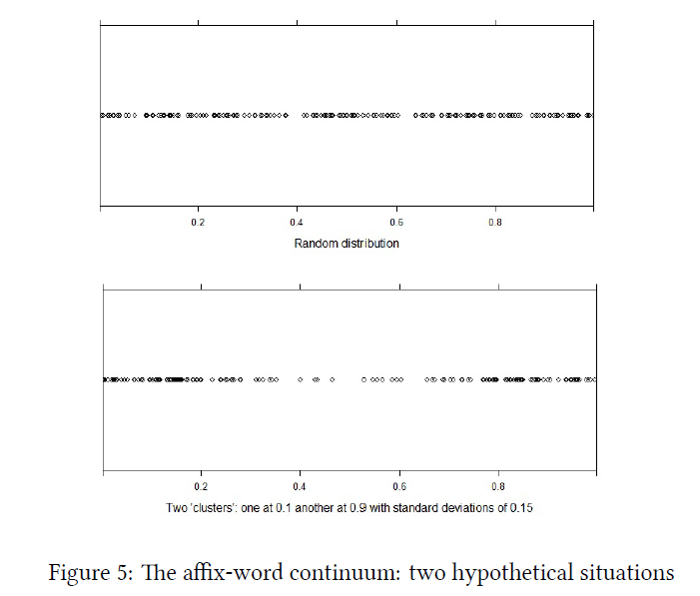
Affix-word continuum
Hierarchical clustering with affix-word database.

Slide 102
Reading
Levshina Chapter 15
Baayen Chapter 5
Bell et al. 2018

